Slide 1

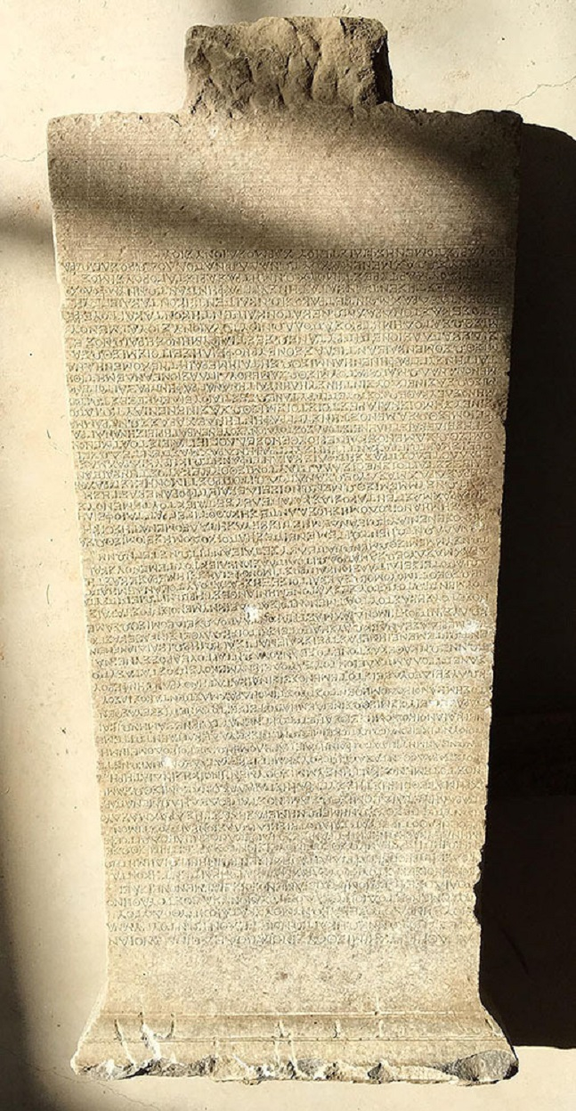
Rethinking Rent
Towards a twenty-first century research agenda for the theory of land-rent
PRESENTED BY:
Marshall M. A. Feldman
Professor Emeritus of Labor Research and Urban Studies
This work is licensed under a Creative Commons Attribution-NonCommercial-NoDerivatives 4.0 International License.

Slide 2
Today's Topics
First Topic
Second Topic

Slide 3
First Topic

Slide 4
Details
Some detail about topic 1
Another detail about topic 1

Slide 5
Second Topic

Slide 6
Details
Interesting point about topic 2
Another interesting point about topic 2

Slide 7
Summary
Quick point to summarize topic 1
Quick point to summarize topic 2

Slide 8
Questions?
CONTACT:
example@fedoraproject.org
License statement goes here. Creative Commons licenses are good.

Slide 9
References
Saxena, Vishakha. 2016. “Archaeologists Uncover 2,200-Year-Old Gymnasium Rent Agreement in Turkey and Its Pretty Extensive.” Newspaper. India Today. October 3, 2016.

